Slide 1
OmniFood

Slide 2
Omni Food
Making recipe easier!

Slide 3
Welcome To Omnifood
This project aims to create a food website with a range of features that will provide an engaging and informative experience for users. The website will have a searchable recipe database with detailed instructions, ingredients, nutritional information, and photos. Users will be able to browse recipes by category, cuisine, dietary requirements, and other filters.

Slide 4
Main Features
Pagination without using the reload button.
Servings according to the requirements of the user.
Fetch data from the API.
Bookmark the recipes.
Making client interaction easy.

Slide 5
Technologies
HTML
It stands for Hyper Text Markup Language which help us to create the structure of the website.
CSS
JAVASCRIPT
It stands for Cascading Style Sheets which help us to design the elements present inside the website.
Being a quite popular programming language it help us to give the functionality in the Website.

Slide 6
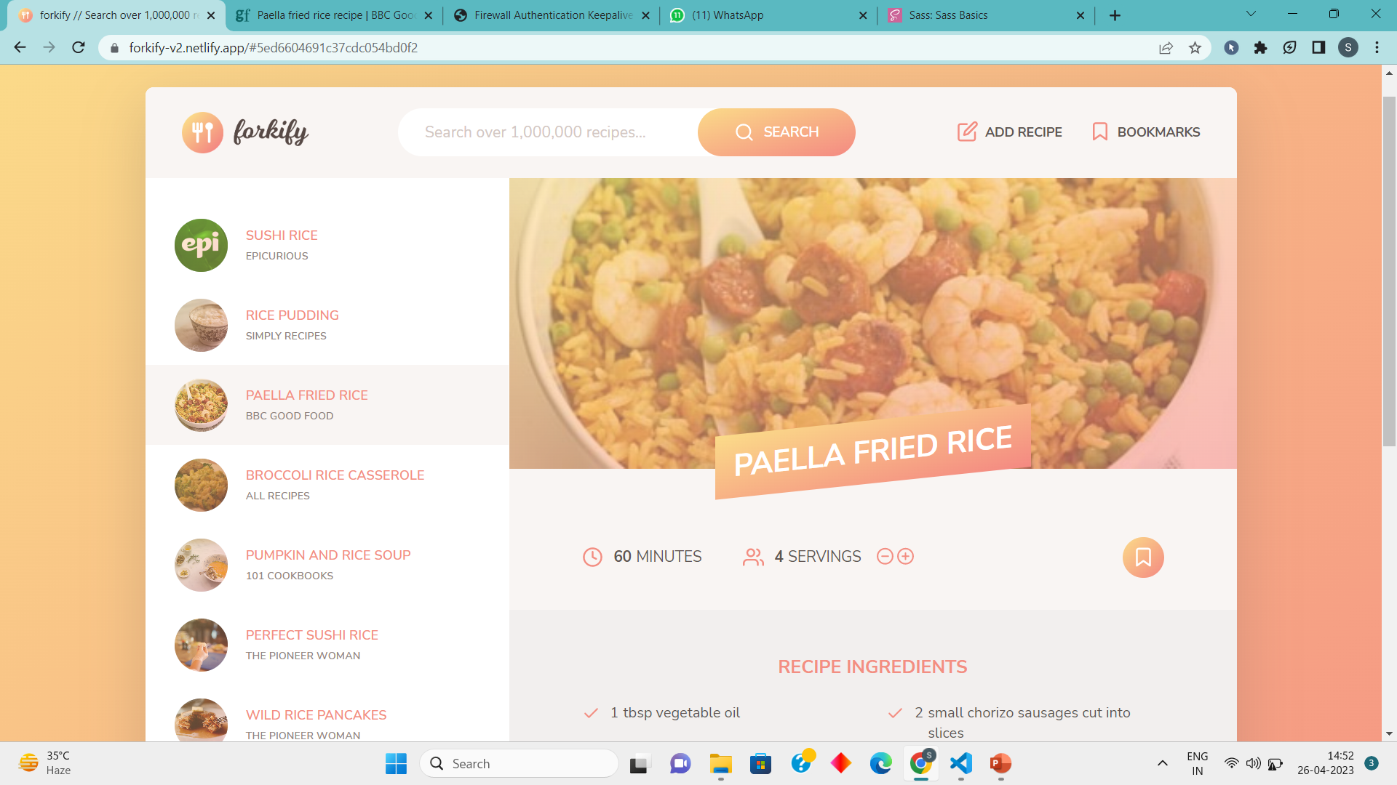
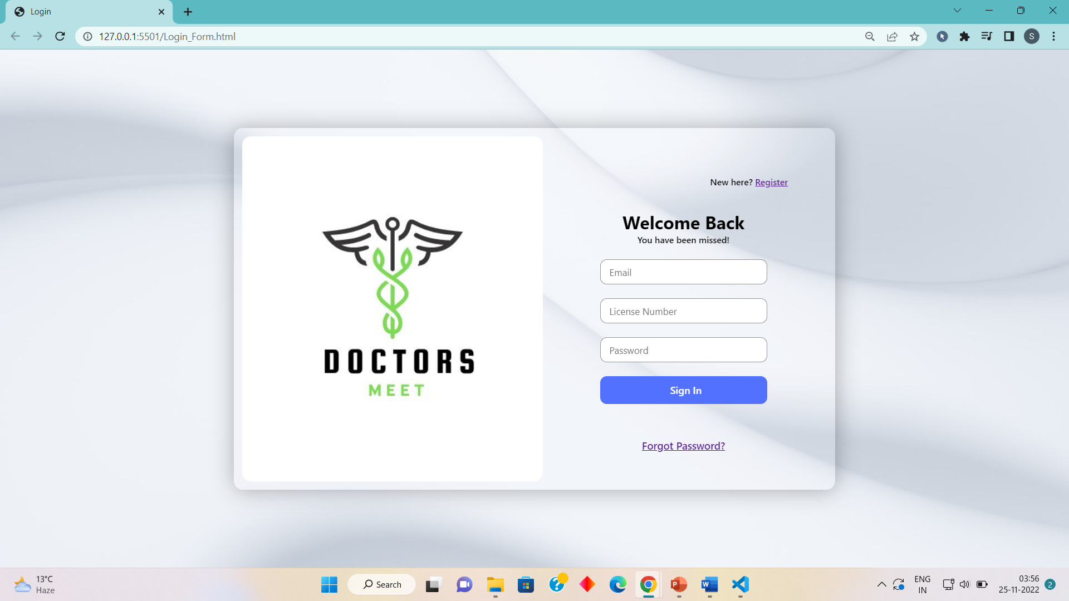
Screenshots

Slide 7
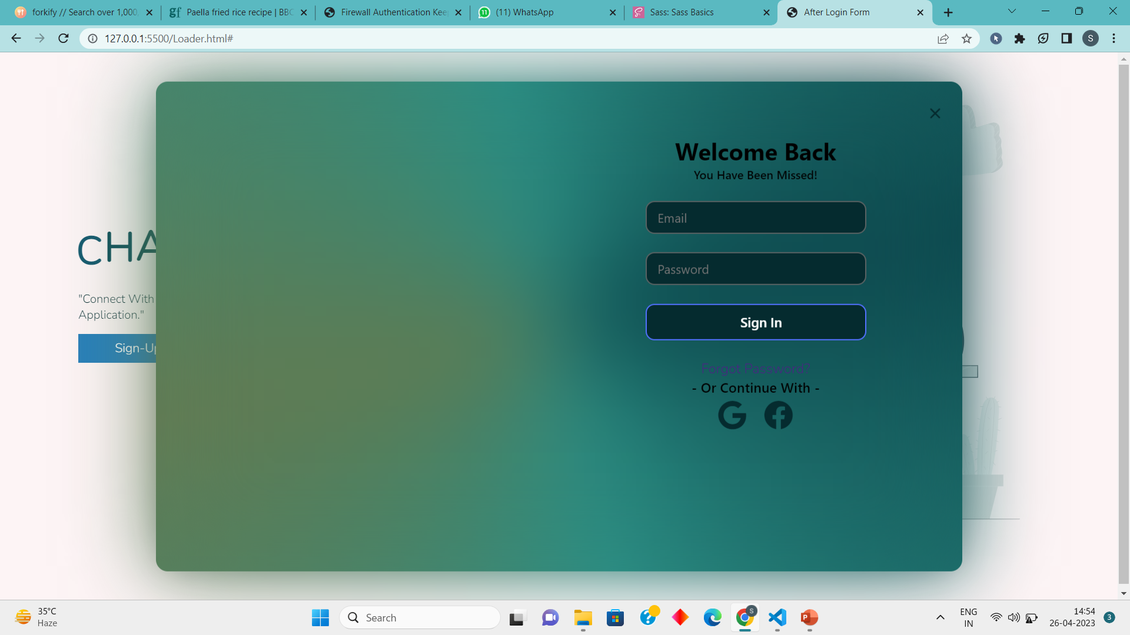
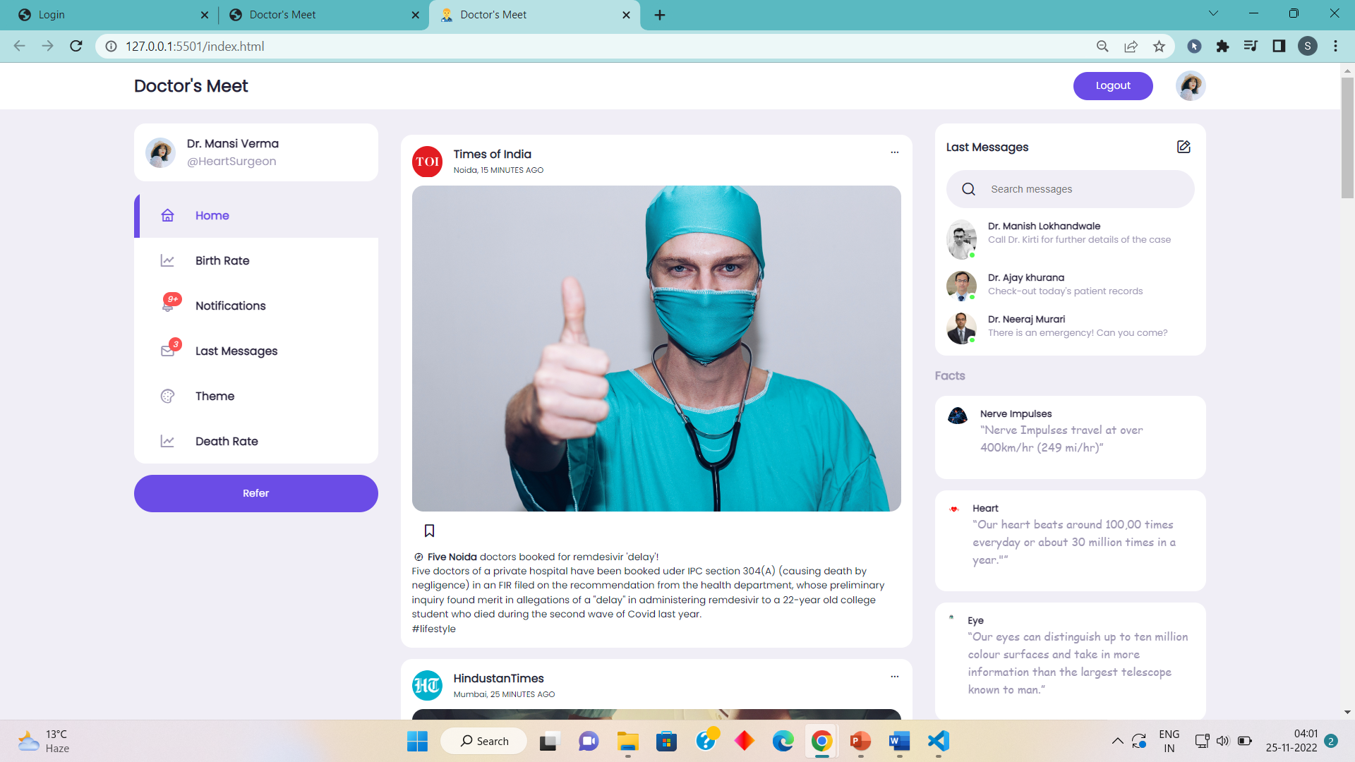
Screenshots

Slide 8
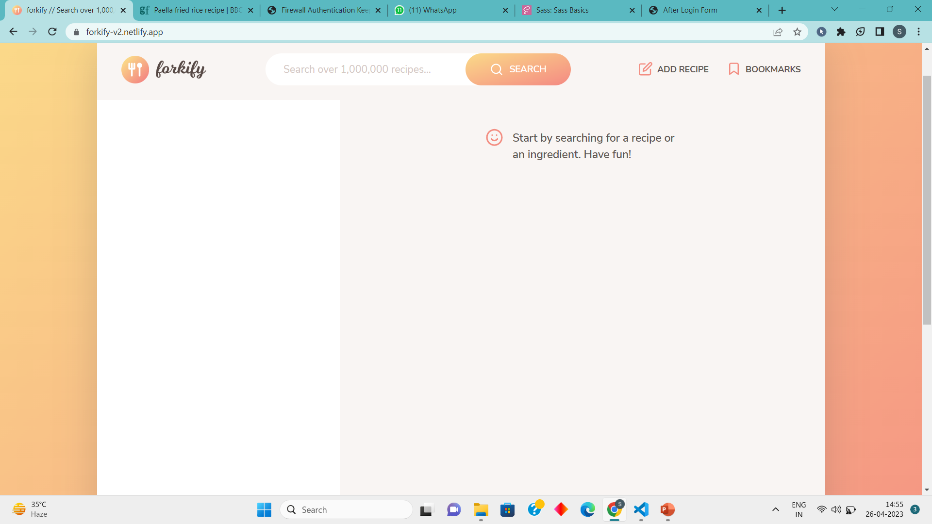
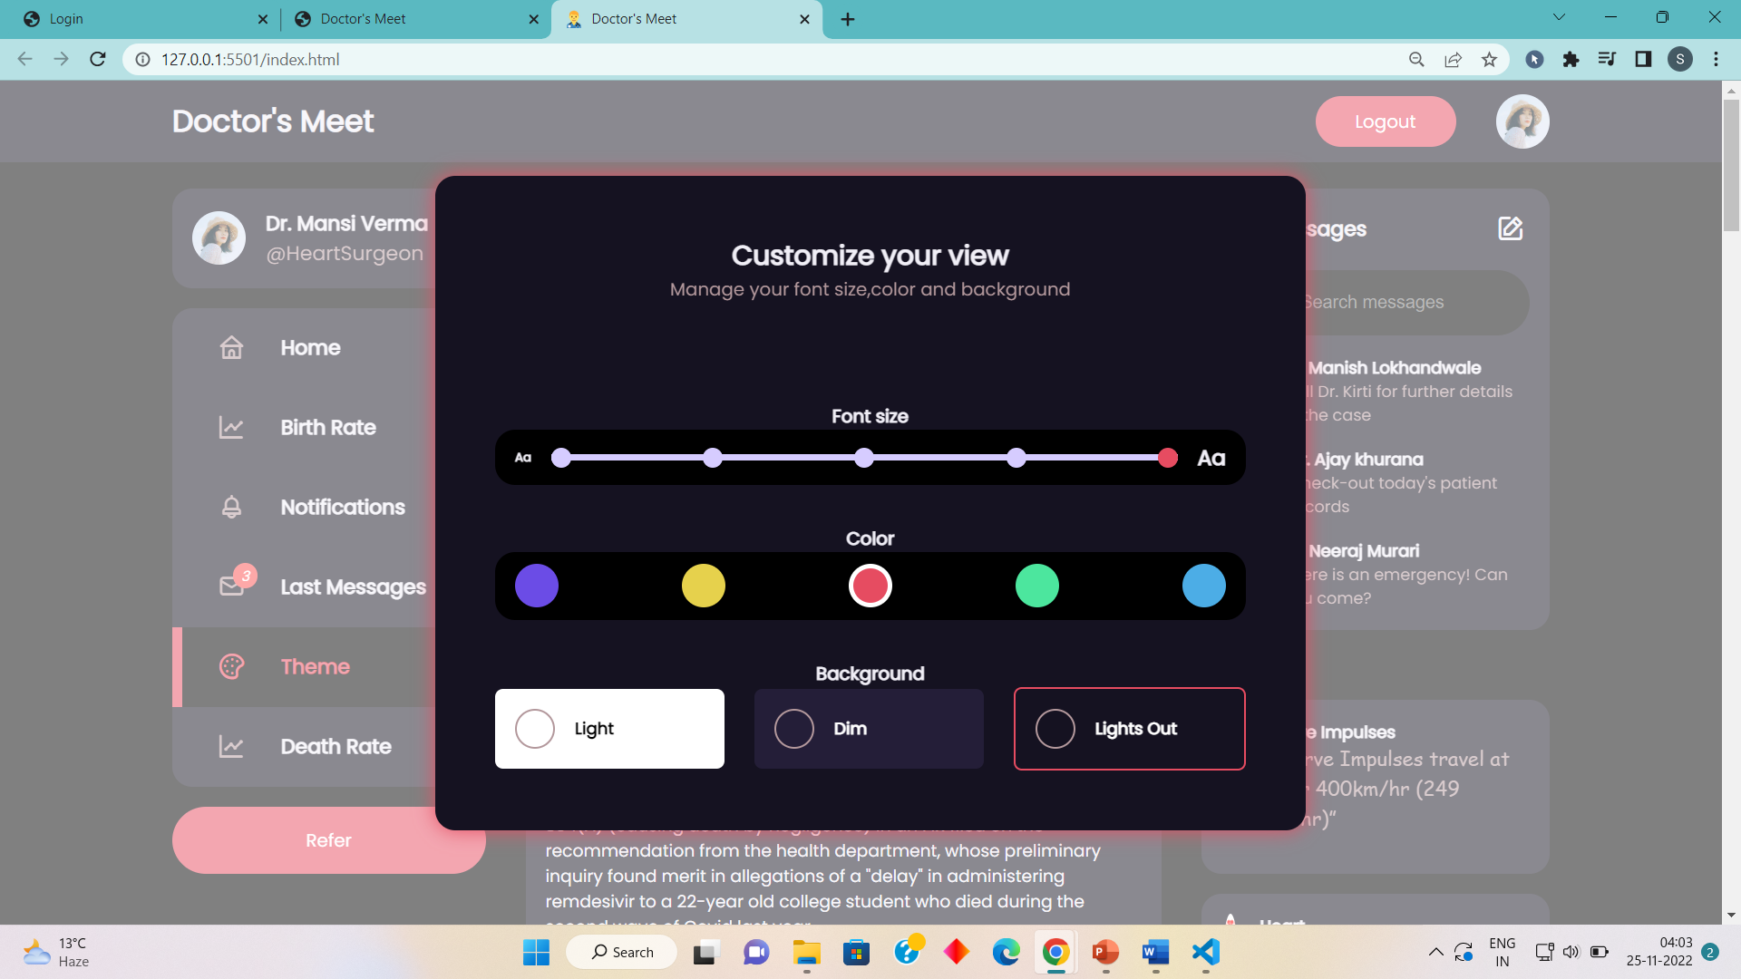
Screenshots

Slide 9
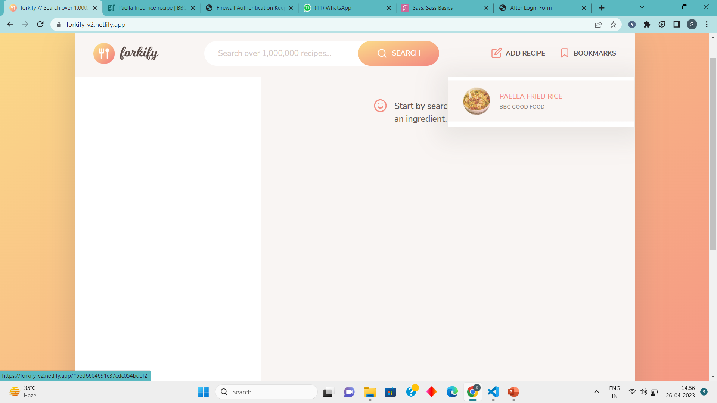
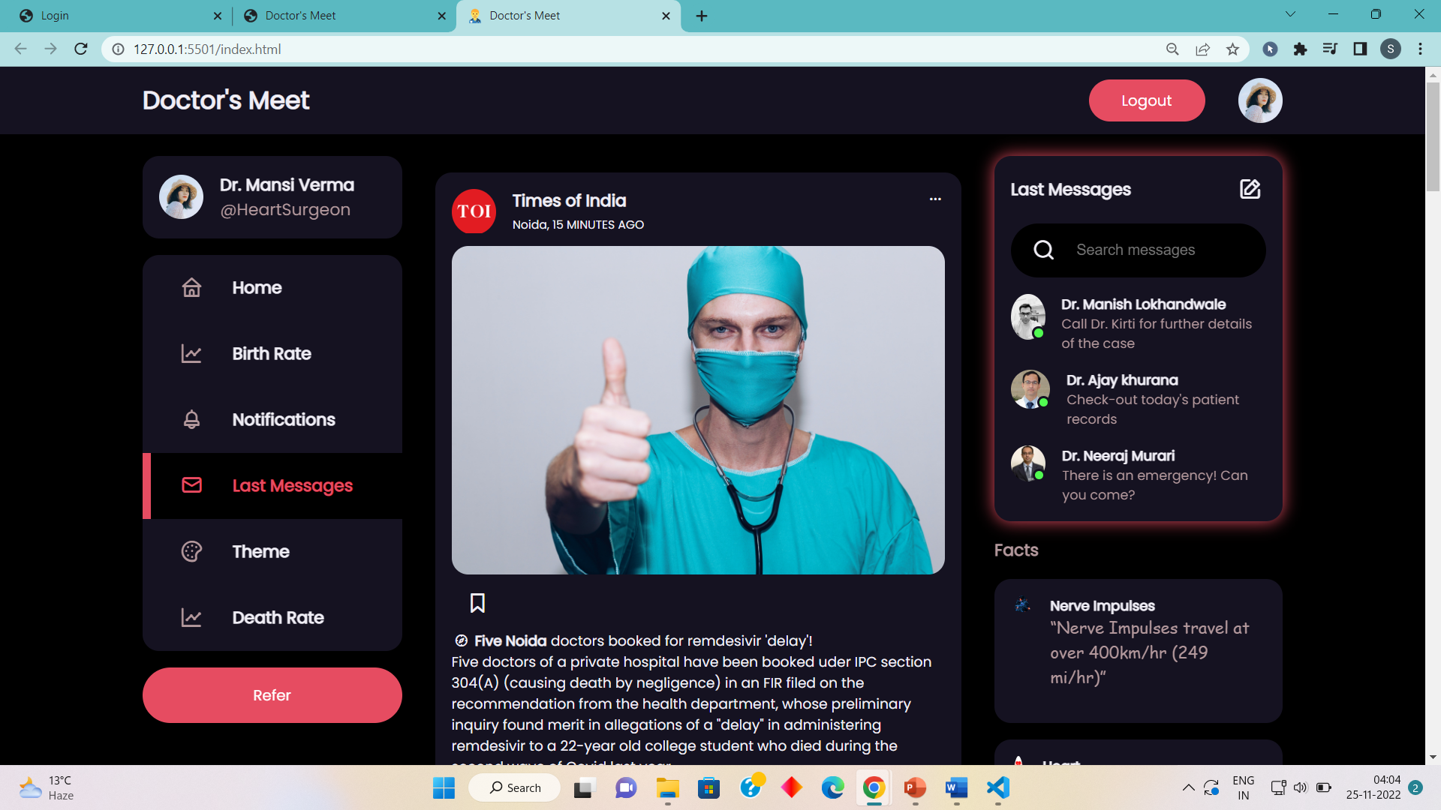
Screenshots

Slide 10
Thank You
Cheers to the ones who save mankind from suffering and sickness and can give life!

Slide 11
Omnifood

